Slide 1
PARASITOLOGY
Rustin High School Invitational
January 6th, 2018

Slide 2
Rules
Each station will last 2 minutes and 45 seconds (2.75 minutes).
Please write Team Name/ Number on EACH answer sheet page
Please write all answers on the lines provided, if writing in the margins please clearly label and underline what is part of your answer.
All tie-breakers will be marked with an asterisk (*)
Improper spelling will result in half credit

Slide 3
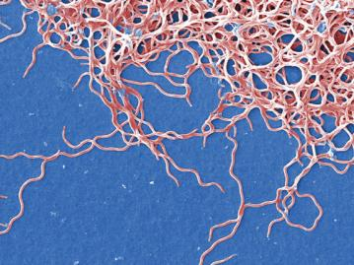
Station A
1. What is the scientific name for this?
2. List two vectors that transmit this to humans in the US. (Common or scientific names are both acceptable)
3. List three ways humans can prevent the spread of this parasite.

Slide 4
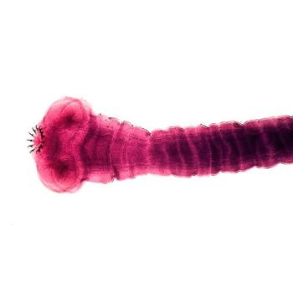
Station B
1. What is the scientific and common name for this?
2. What is a section of this organism’s body called? Why is it important for it’s reproduction?
3. Briefly describe three ways this organism can be transmitted

Slide 5
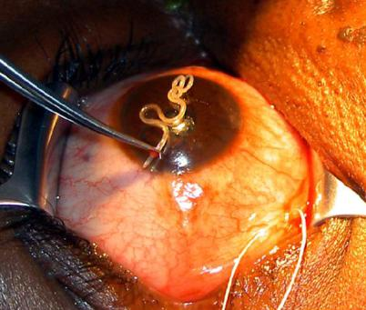
Station C
1. What is the scientific name for this?
2. What does its scientific name mean?*
3. Where is this considered endemic?

Slide 6
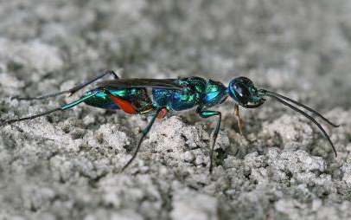
Station D
1. What is the scientific name for this?
2. What is the host of this arthropod?
3. Is this organism toxic or venomous? How does the substance it produces affect its host physiologically?

Slide 7
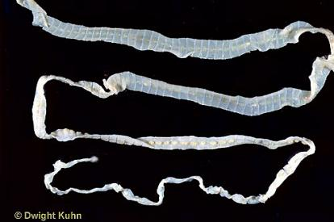
Station E
1. What is the scientific name for this?
2. What is the first intermediate host of this parasite?
3. What are some impacts it can have on a human host? List six for full credit.*

Slide 8
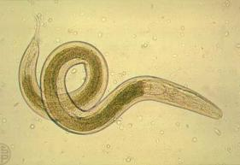
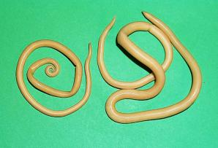
Station F
Answers to these questions are related to the two organisms pictured above.
1. What is the scientific name for the most common parasitic worm world wide?
2. How is it transmitted to humans?
3. What is the scientific name for the most common intestinal parasitic worm in the United States?
4. How is it transmitted to humans?

Slide 9
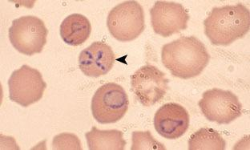
Station G
1. What is the scientific name for the organism labeled with the arrow.
2. In the box provided on your answer sheet. Draw the life cycle of this parasite. Label the hosts and life stages.

Slide 10
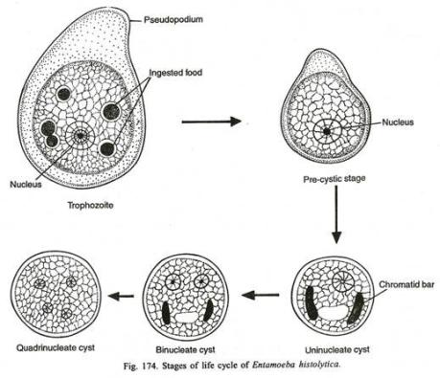
Station H
1. What is the scientific name for the organism who’s life cycle is portrayed here?
2. Label the anatomical features labeled A, B, & C.
3. Label the Life Stages labeled I, II, III, IV, and V.
A
A
B
II
I
C
V
IV
III

Slide 11
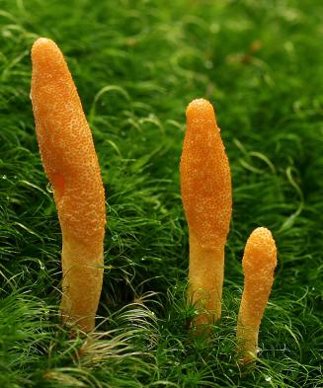
Station I
1. What is the host of Cordyceps militaris?
2. What is scientific name for the prefered host of Ophiocordyceps unilateralis?
3. Describe the difference between Beauveria bassiana and Cordyceps bassiana.

Slide 12
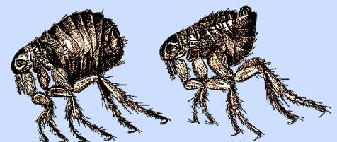
Station J
1. What is the scientific name for the organisms pictured?
2. Which of the organisms is the female? (Right or Left)
3. What famous disease that has killed millions of humans is spread by this parasite? (Common or scientific name acceptable)
4. List a common host (excluding humans) for this parasite
4. This organism is holometabolous. What does holometabolous mean? Describe the stages of holometabolism.

Slide 13
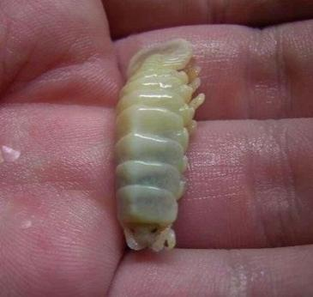
Station K
1. What is the scientific name for this?
2. How does this parasite enter its host?
3. What part of the host does this feed on?
4. Explain what is unique about this isopod’s gender.

Slide 14
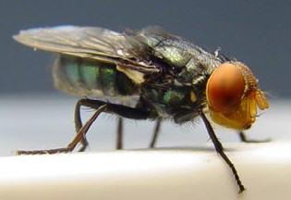
Station L
1. What is the scientific and common names for this insect?
2. This parasite performs a process called “myiasis”. Define Myiasis.
3. How many eggs can a female lay?
4. When and how was this organism eradicated from the United State?

Slide 15
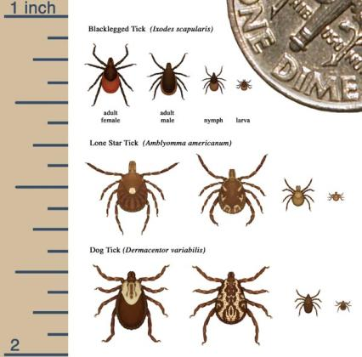
Station M
1. Which one of the following is Ixodes scapularis? (A, B, or C)
2. List two common names for Ixodes scapularis.
3. List three parasites that can be transmitted via Ixodes scapularis.
A
B
C

Slide 16
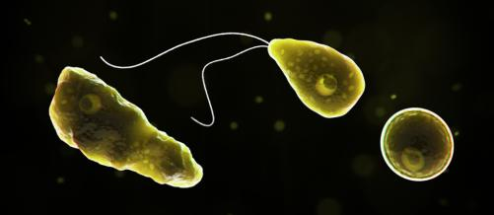
Station N
1. What is the scientific name for the parasite pictured?
2. How does this parasite infect its host?
3. In what water temperature does this organism grow best? Full credit will be given for approximate degrees.
4. When and where in the United States do most infections with this parasite occur?

Slide 17
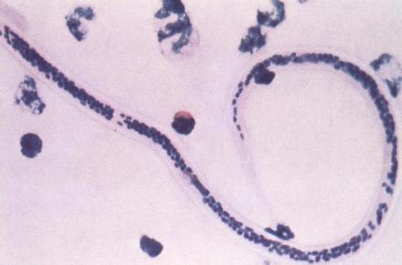
Station O
1. What is the scientific name for this parasite?
2. How is it spread to humans?
3. How often do human hosts die from this parasites? Give answer in percent for full credit*

Slide 18
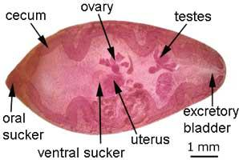
Station P
1. What is the scientific name for this organism?
2. Label A, B, and C?*
3. What part of the host is most affected?
4. What is the major route of transmission to mammals?
C
A
B

Slide 19
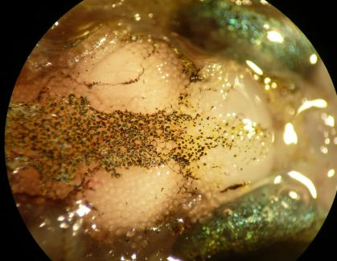
Station Q
1. What is the scientific name for the parasite shown here?
2. What is its habitat? Be as specific as possible
3. How does the parasite affect the behavior of its aquatic host? How does this increase its transmission?
4. In what host do the cysts of this parasite hatch?

Slide 20
REMAINING TIME MAY BE USED TO CHECK YOUR ANSWERS.

